Slide 1
Do Now
What are the subunits of a nucleic acid?
Give an example of a nucleic acid.
Where do we find nucleic acids in a eukaryote?
Where do we find nucleic acids in a prokaryote?
What is the test for nucleic acids?

Slide 2
DNA Reading
20 min.

Slide 3
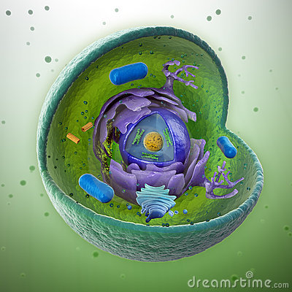
Where are we?!

Slide 4
nucleus
chromosome
DNA
gene
cell

Slide 5
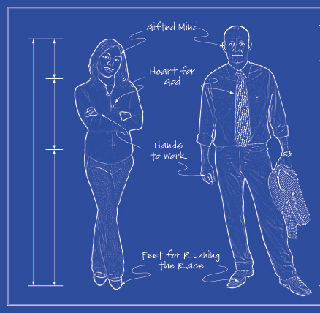
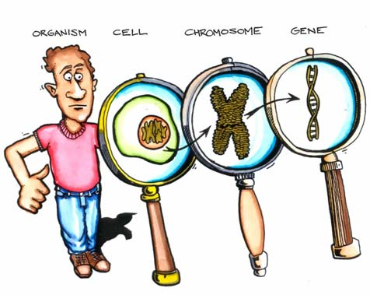
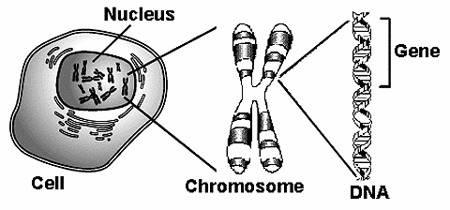

Slide 6
Do Now
What are the 3 parts of a nucleotide?
What are the 4 nitrogenous bases?
How do these bases pair up?
What does a DNA molecule look like?
What makes up the backbone of a nucleic acid?
6. In every microscopic human cell, there is 1 meter of DNA in EACH cell. That’s about 3 feet!!!! How is our DNA efficiently compacted in our cells? (Hint: we have 46 of them).

Slide 7
DNA
nucleic acid
nucleotides
nucleus
cytoplasm
99
nucleus
chromosomes

Slide 9
phosphate
A
deoxy-
ribose
T
phosphate
deoxy-
ribose
phosphate
G
deoxy-
ribose
C
phosphate
deoxy-
ribose

Slide 10
thymine
T
guanine
G
T A A T A G C A T
hydrogen
weak

Slide 11
DNA Structure

Slide 12
15 min.

Slide 14
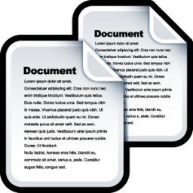
“Replication”

Slide 15
Why “copy”our DNA?!

Slide 16
When DNA copies itself
the act of copying
Nucleus=Eukaryotic; Cytoplasm= Prokaryotic
grow reproduce
new
copy
copy
before
divides
unzips
hydrogen
T G
enzyme
proofreads

Slide 17
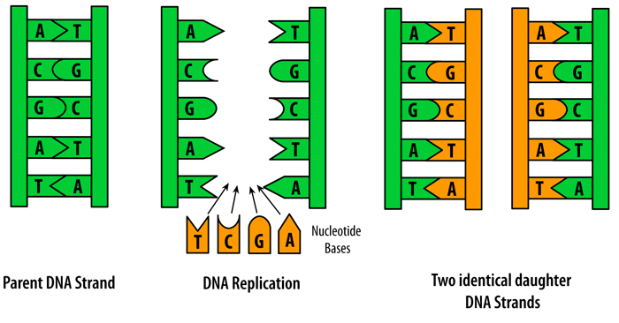
“semi-conservative”
semi-conservative
1
1
partially
contains original strand

Slide 18
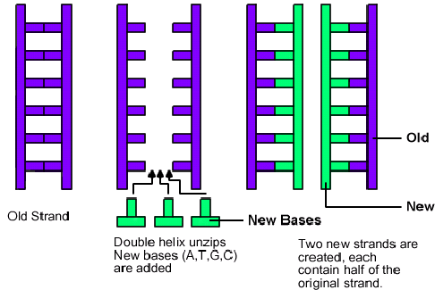

Slide 19
DNA Replication Animation
http://www.stolaf.edu/people/giannini/flashanimat/molgenetics/dna-rna2.swf
https://www.youtube.com/watch?v=zdDkiRw1PdU

Slide 20
Draw it! (3 minutes)

Slide 21
DNA Replication Review
http://www.youtube.com/watch?v=zdDkiRw1PdU
http://www.youtube.com/watch?v=z685FFqmrpo

Slide 22
Wrap Up Questions
Explain the first step of DNA replication. Be specific!
What is the enzyme responsible for “proofreading” the new DNA?
Explain the importance of the proofreading step. What could ultimately happen if this step were overlooked?
Why is it important for DNA to replicate BEFORE mitosis/cellular division?

Slide 23
Cell Cycle
Interphase
Mitosis
10
24
90

Slide 25
Cell Cycle Stages
Interphase
(G1, S, G2)
Cell increases in size
DNA Replication
Preparation for mitosis
Mitosis: division of the nucleus into 2 identical daughter nuclei; Prophase, metaphase, anaphase, telophase
Division of the cell & cytoplasm

Slide 26
Cell Cycle
Interphase
Mitosis
10
24
90

Slide 27
growth
2n
identical
1

Slide 28
Mitosis

Slide 29
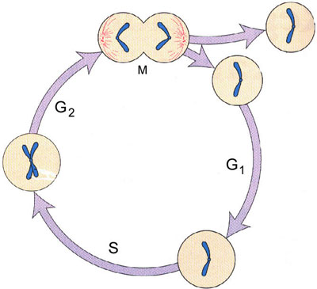

Slide 32
Mitosis Animation
http://www.stolaf.edu/people/giannini/flashanimat/celldivision/crome3.swf
http://www.johnkyrk.com/mitosis.html
http://www.cellsalive.com/mitosis.htm
http://www.youtube.com/watch?v=HYKesI9jL8c

Slide 33
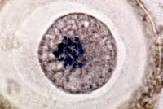
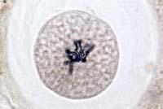
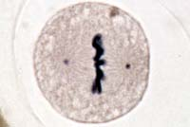
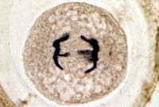
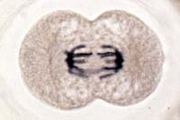
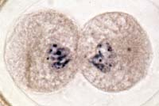
Animal Cell
Interphase | Prophase
Metaphase | Anaphase
Telophase | Interphase

Slide 34
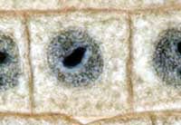
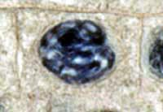
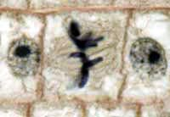
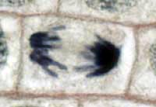
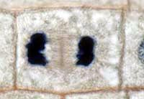
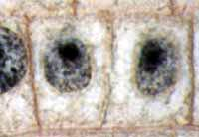
Plant Cell
Interphase | Prophase
Metaphase | Anaphase
Telophase | Interphase

